Slide 1

Google Data Analytics: Capstone Project
Cyclistic Bike Share Analysis
Tableau
GitHub

Slide 2
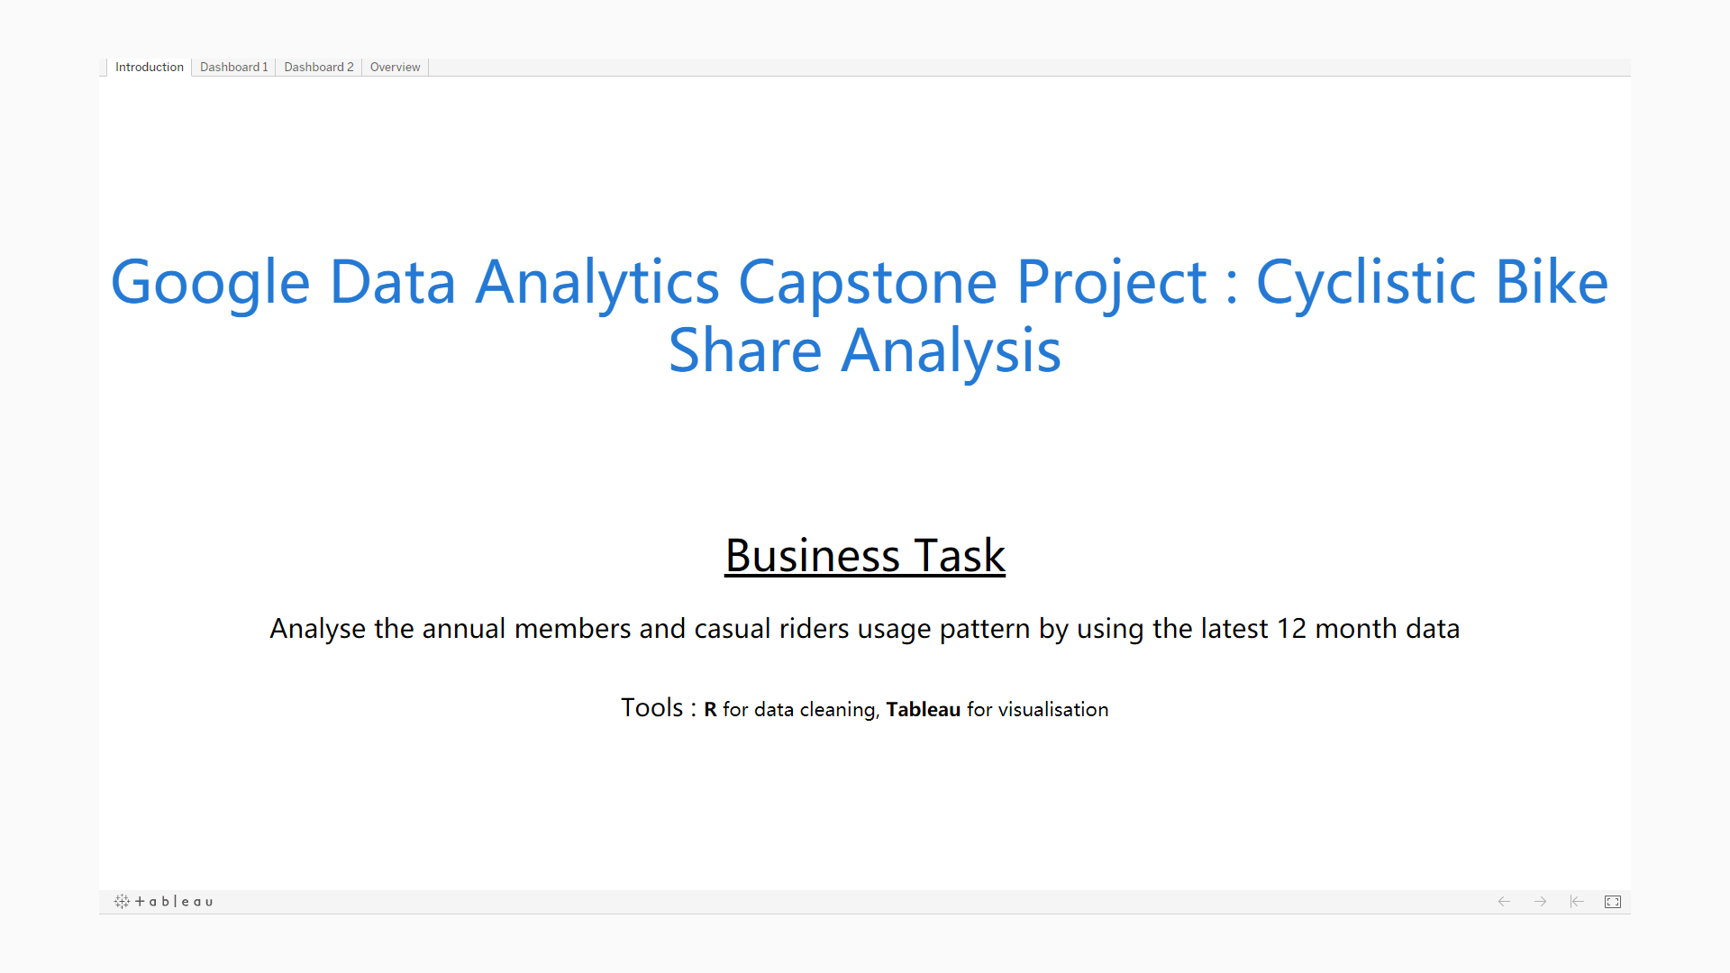

Slide 3
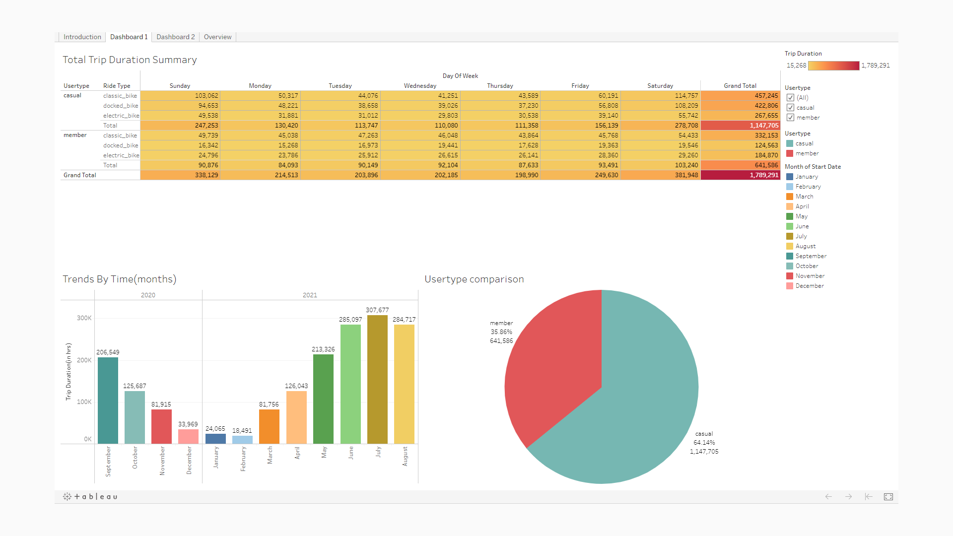

Slide 4
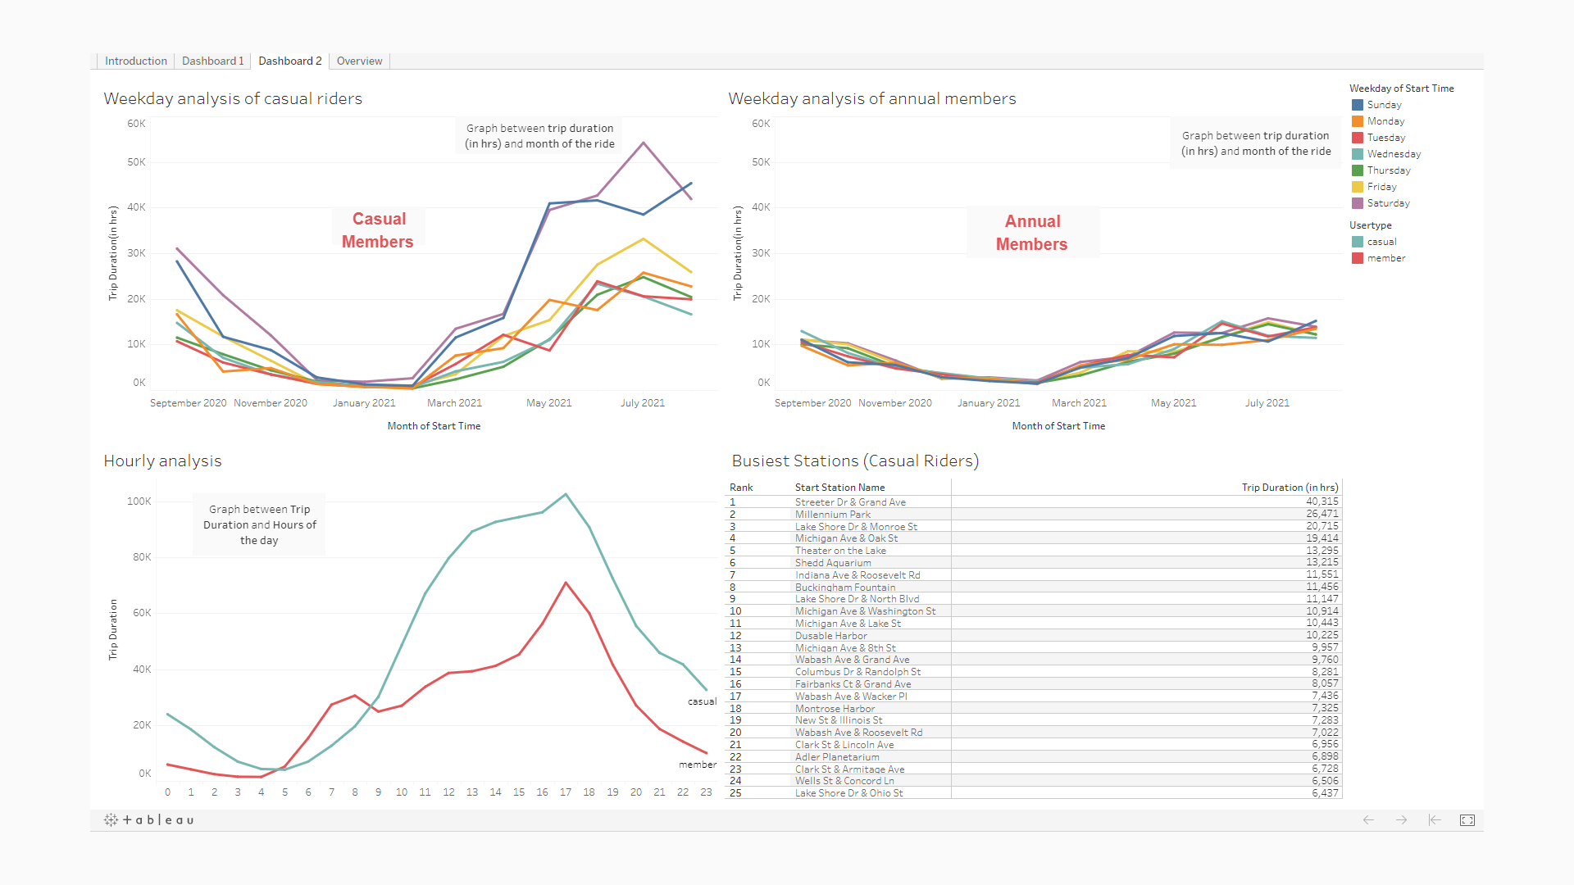

Slide 5
